Slide 1
Bankruptcy Prevention Using Machine Learning
Analysis and Model Building

Slide 2
Introduction
Objective :-
Predict bankruptcy using machine learning models.
Dataset: -
Bankruptcy prevention data.

Slide 3
Dataset Overview
Source: "bankruptcy-prevention.xlsx"
Features: Financial flexibility, credibility, industrial risk, etc.
Target: Bankruptcy status (binary: 0 = bankruptcy, 1 = non-bankruptcy).

Slide 4
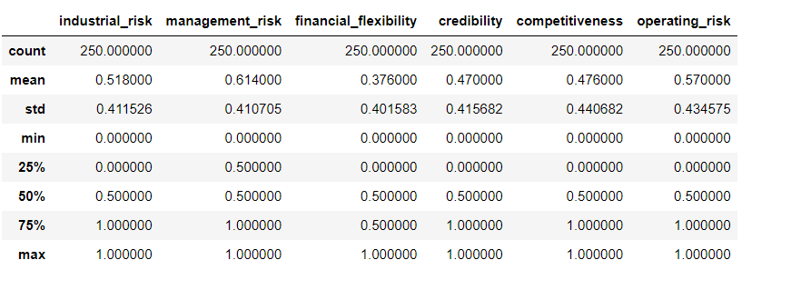
Descriptive Statistics
Summary statistics of the dataset (mean, median, standard deviation, etc.).

Slide 5
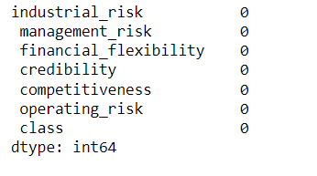
Missing Values
Check for Missing Values: Summary of any missing values in the dataset.

Slide 6
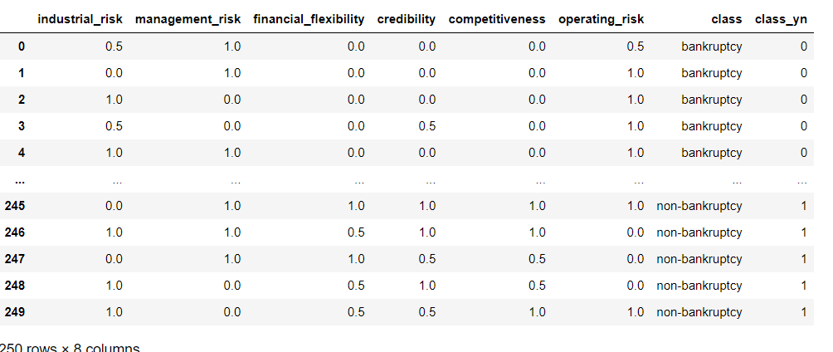
Target Variable Transformation
Transformation: Explanation of how the target variable was transformed (bankruptcy = 0, non-bankruptcy = 1).

Slide 7
Exploratory Data Analysis (EDA)
EDA: Overview of the exploratory data analysis performed.
Count Plots: Visualize different features against the target variable.
Cross Tabs: Show relationships between categorical variables.

Slide 8
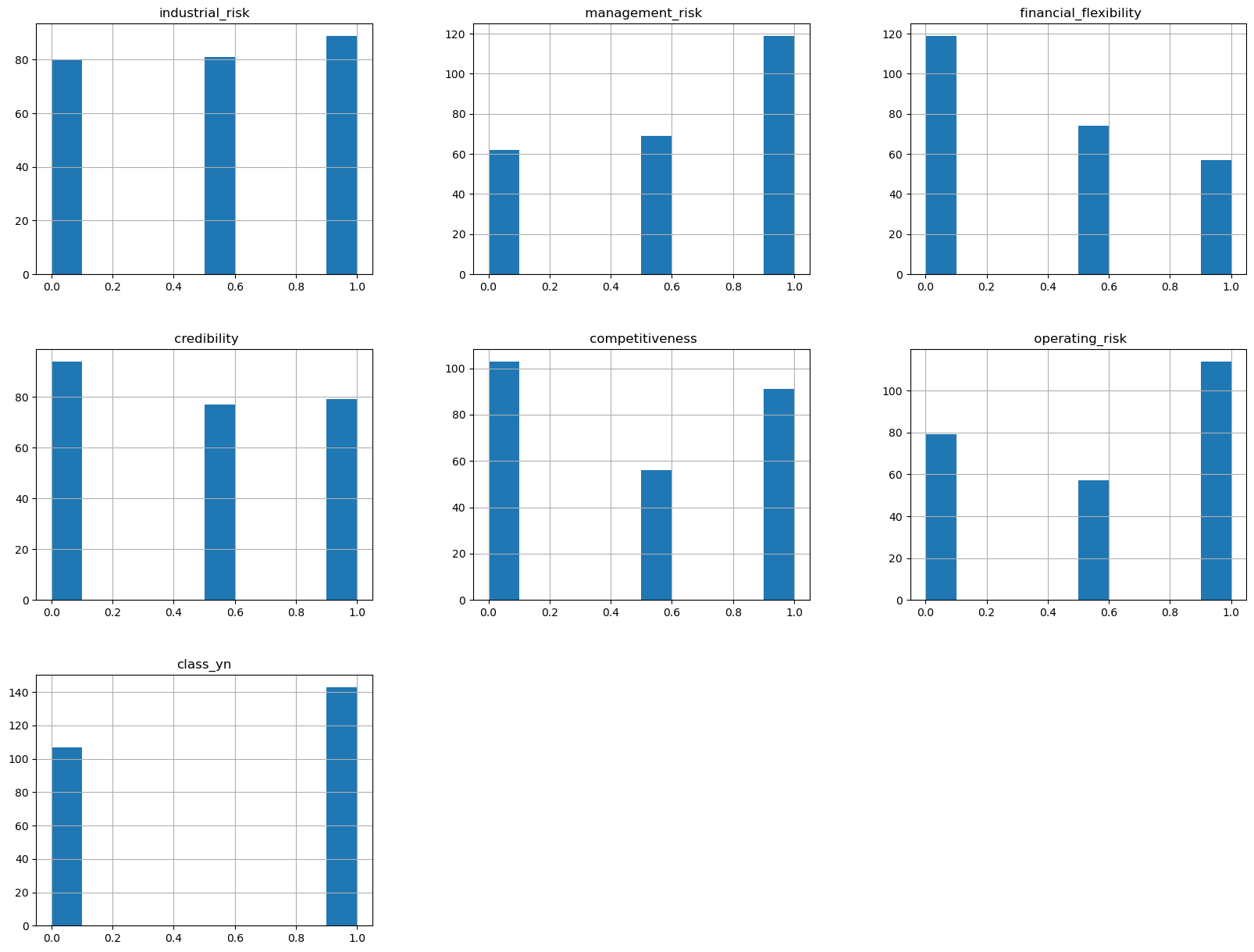
Histograms
Histograms: Display histograms for the numerical features.

Slide 9
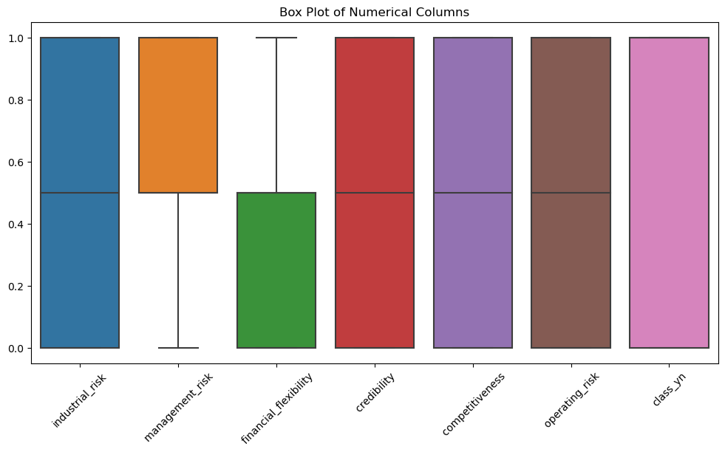
Boxplots
Boxplots: Display box plots for numerical columns to check for outliers.

Slide 10
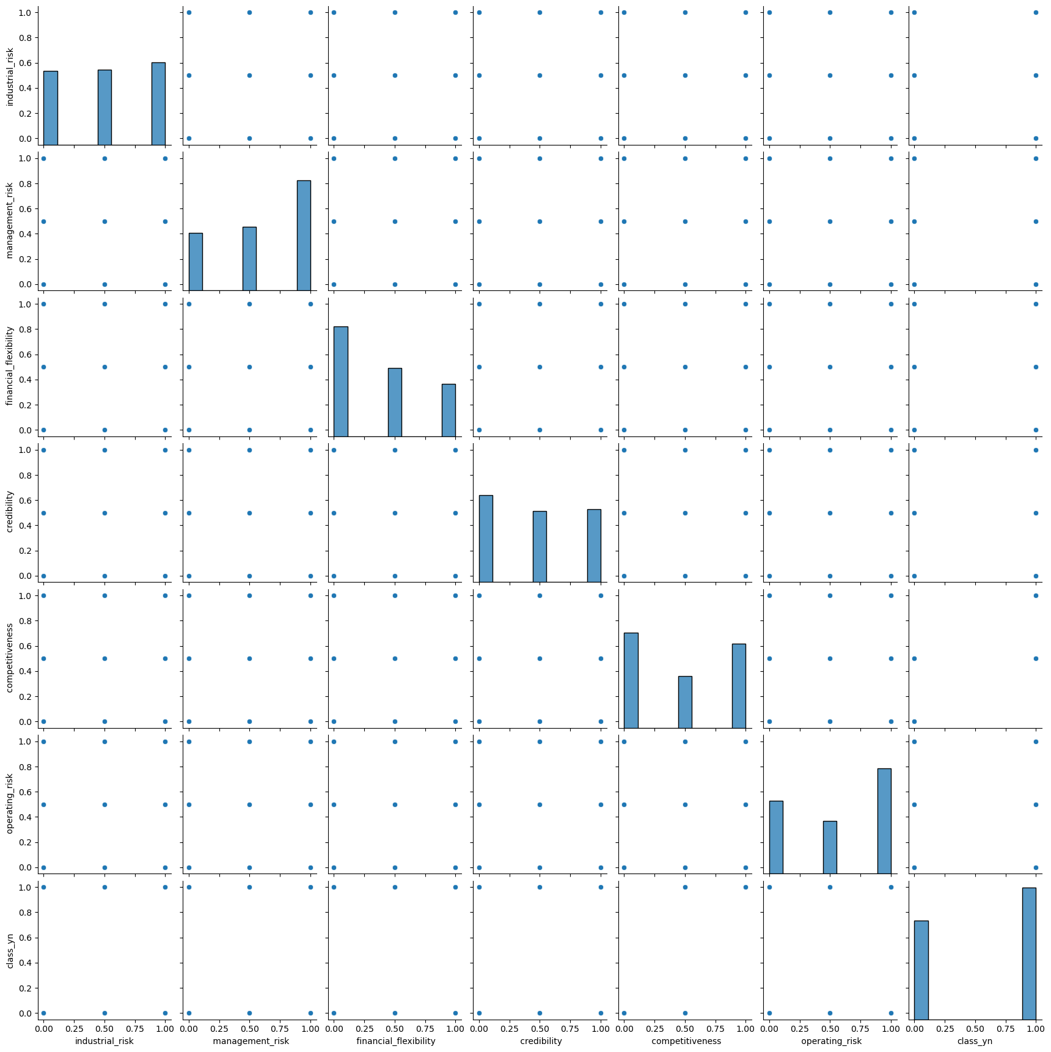
Pairplots
Pairplots: Display pair plots to visualize relationships between variables.

Slide 11
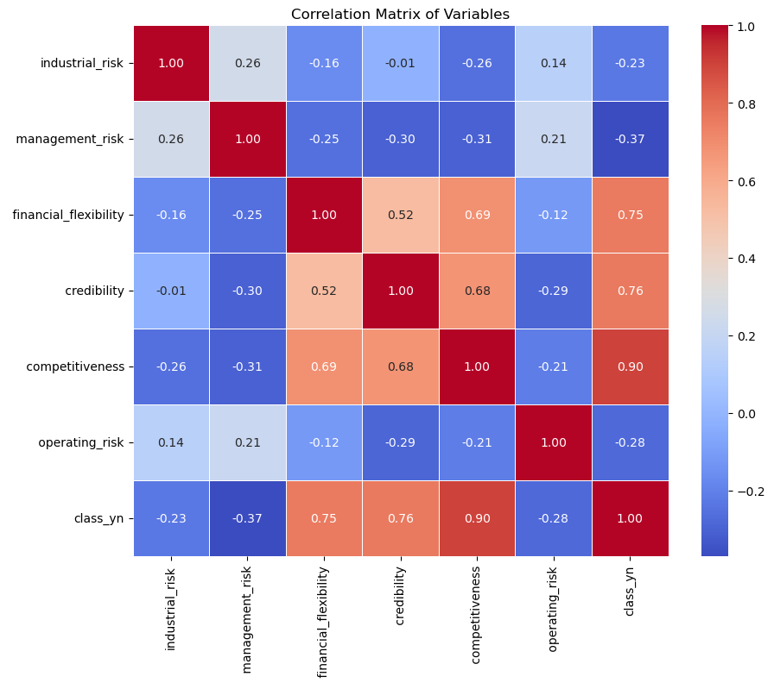
Correlation Matrix
Correlation Matrix: Display and explain the correlation matrix.

Slide 12
Feature Engineering
Feature Engineering: Briefly explain the features and target variable used for model building.
Variables: x (features), y (target variable).

Slide 13
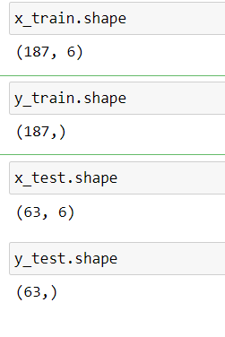
Train-Test Split
Train-Test Split: Explain the splitting of data into training and test sets.

Slide 14
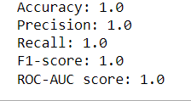
Logistic Regression Model
Logistic Regression: Overview of the logistic regression model.

Slide 15
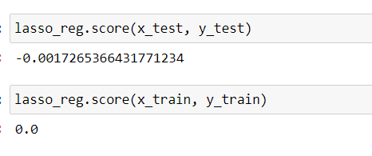
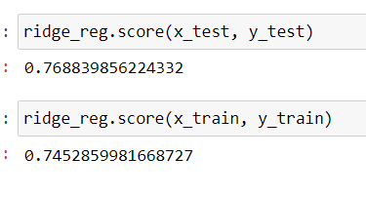
Regularization Techniques
Regularization: Explanation of L1 (Lasso) and L2 (Ridge) regularization.
Lasso:
Ridge:

Slide 16
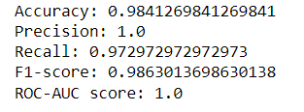
K-Nearest Neighbors (KNN) Model
KNN Model: Overview of the KNN model.

Slide 17

Support Vector Machine (SVM) Model
SVM Model: Overview of the SVM model and different kernels (linear, RBF, polynomial).
Linear Kernel :-
The linear kernel is used when the data is linearly separable.

Slide 18
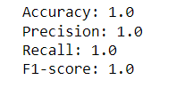
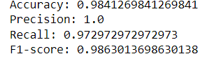
Radial Basis Function (RBF) Kernel :-
The RBF kernel is a popular choice for non-linear data.
Polynomial Kernel
The polynomial kernel is used for polynomially separable data.

Slide 19
Model Comparison and Conclusion
Best Model
Selected Model: Polynomial SVM
Reason for Selection:
Highest Accuracy: 0.86
Best Precision: 0.82
Best Recall: 0.89
Best F1-Score: 0.85
Highest ROC-AUC: 0.91

Slide 20
Conclusion
Overall Performance:
Summarize the overall performance of the models.
Best Performing Model:
Polynomial SVM, which achieved the highest scores across all metrics.
Implications:
Discuss the practical implications of the model's predictions for preventing bankruptcy.

Slide 21
Model Deployment
Introduction
Objective: Deploy the Support Vector Machine (SVM) model for bankruptcy prediction using Streamlit.
Tool:
(“ Streamlit “) - An open-source app framework for machine learning and data science projects.

Slide 22
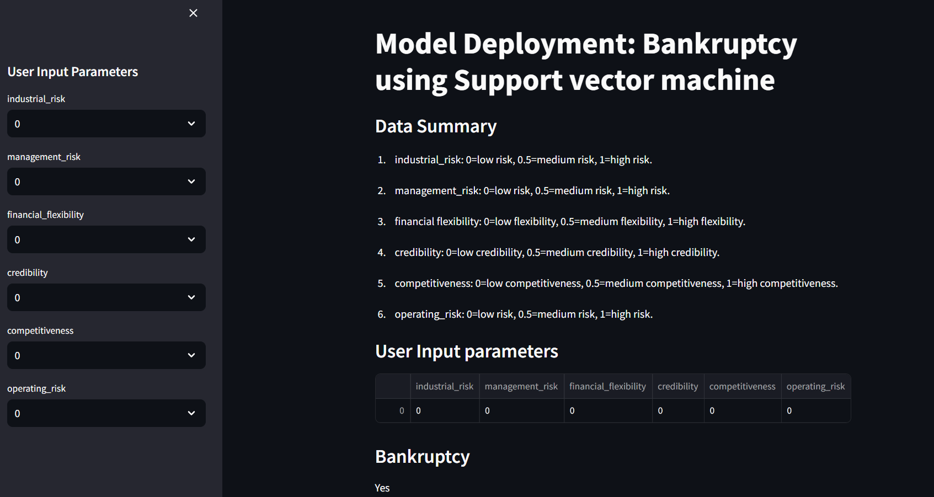

Slide 23
User Interface
Title: "Model Deployment: Bankruptcy using Support Vector Machine"
Sidebar: Allows users to input parameters:
Industrial Risk: Options - 0 (low risk), 0.5 (medium risk), 1 (high risk)
Management Risk: Options - 0 (low risk), 0.5 (medium risk), 1 (high risk)
Financial Flexibility: Options - 0 (low flexibility), 0.5 (medium flexibility), 1 (high flexibility)
Credibility: Options - 0 (low credibility), 0.5 (medium credibility), 1 (high credibility)
Competitiveness: Options - 0 (low competitiveness), 0.5 (medium competitiveness), 1 (high competitiveness)
Operating Risk: Options - 0 (low risk), 0.5 (medium risk), 1 (high risk)

Slide 24
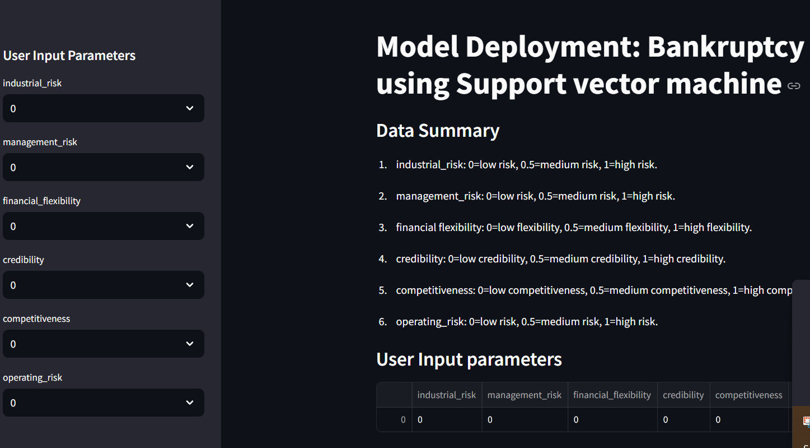

Slide 25
Data Summary
Descriptions: Clarifies what each input parameter represents:
Industrial Risk: 0=low risk, 0.5=medium risk, 1=high risk
Management Risk: 0=low risk, 0.5=medium risk, 1=high risk
Financial Flexibility: 0=low flexibility, 0.5=medium flexibility, 1=high flexibility
Credibility: 0=low credibility, 0.5=medium credibility, 1=high credibility
Competitiveness: 0=low competitiveness, 0.5=medium competitiveness, 1=high competitiveness
Operating Risk: 0=low risk, 0.5=medium risk, 1=high risk

Slide 26
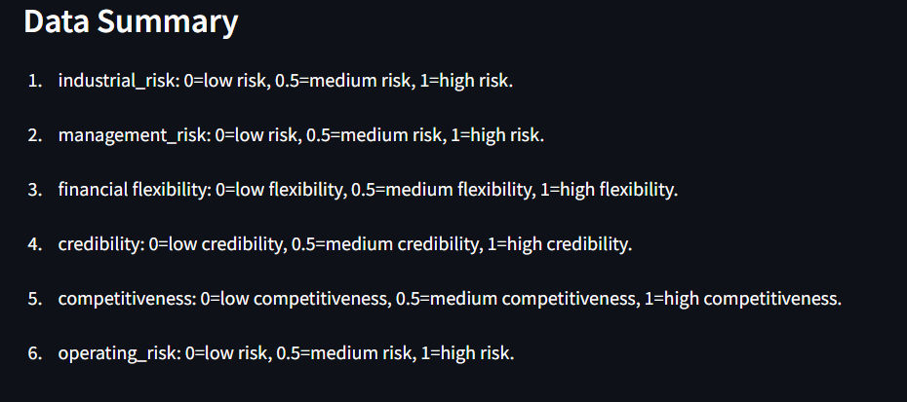

Slide 27
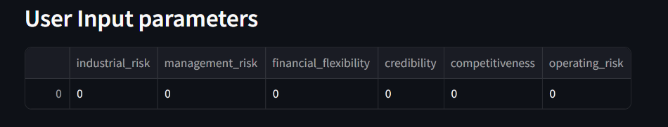
User Input
Feature Display: Shows the user input parameters.
Data Cleaning: Ensures proper formatting and consistency:
Stripping whitespace from column names.
Mapping 'bankruptcy' class to 0 and 'non-bankruptcy' class to 1.

Slide 28
Model Training
Feature Matrix (X): Includes all features except the target variable.
Target Variable (Y): The binary outcome indicating bankruptcy (1) or not (0).
Model: SVM with a polynomial kernel, trained on the provided data.
Prediction: Determines the probability of bankruptcy based on user inputs.

Slide 29
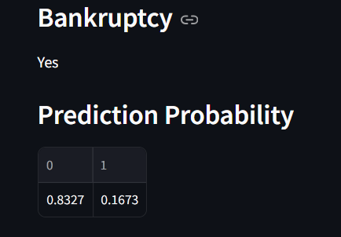
Output
Bankruptcy Prediction: Displays 'Yes' if the predicted probability of bankruptcy is greater than 0.5, otherwise 'No'.
Prediction Probability: Provides the detailed probability scores for each class.

Slide 30
THANK YOU

